Slide 1
Minor Skilled
Final Presentation
Nils Meijer 466301 | 04-07-2023

Slide 2
TABLE OF CONTENTS
01
02
03
04
Introduction
Learning goals & problem solving
Product demonstration
Highlights 1/2
05
06
07
08
09
Highlights 2/2
Quality Assurance
Hour
registration
Possible
future plans
Self Reflection

Slide 3
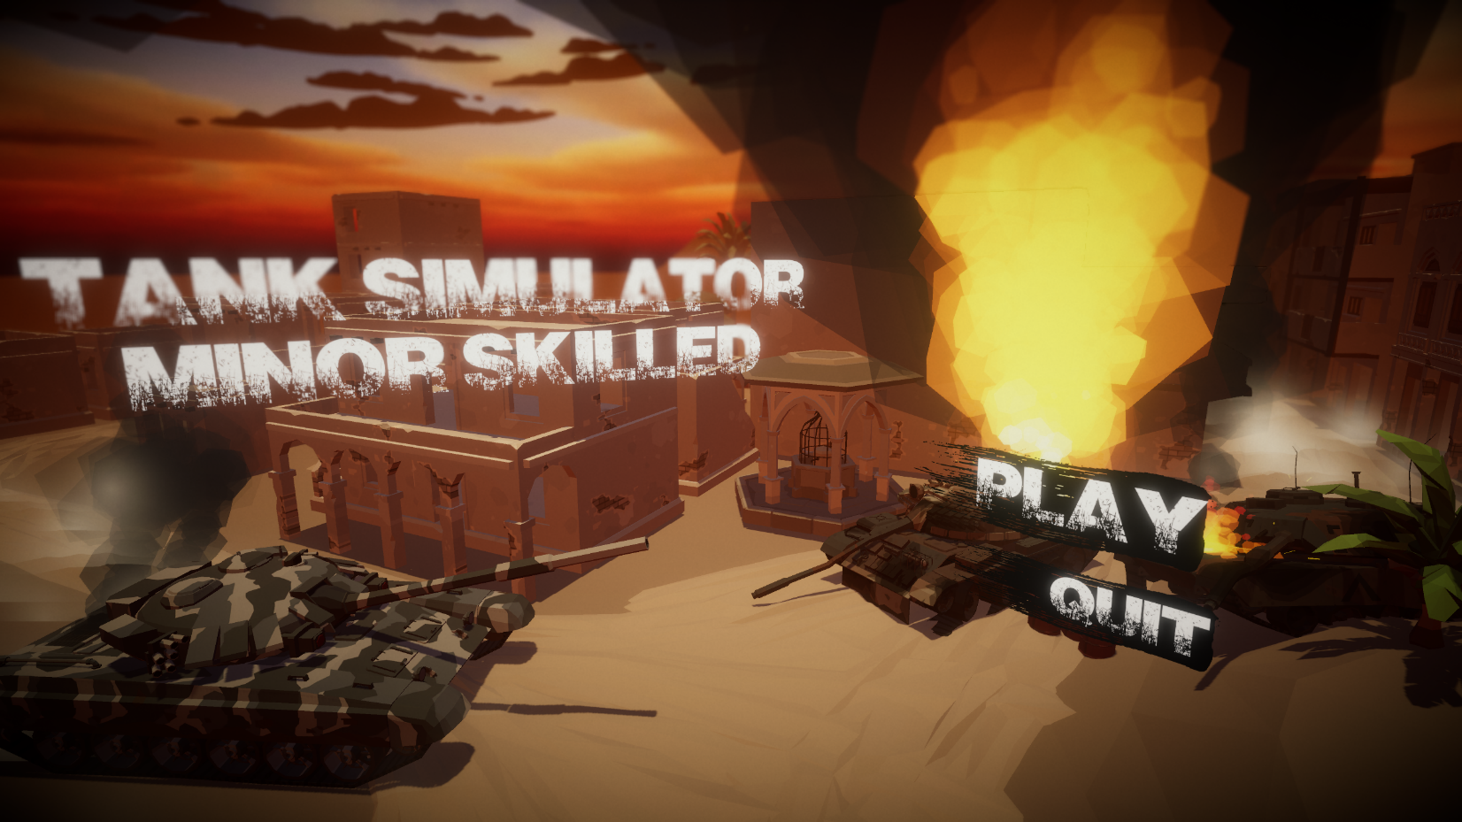
Introduction
01
Low-poly tank combat game/simulator
Explore the level, engage with enemy AI to the death

Slide 4
Learning goals
02
AI development: expand knowledge on AI techniques , specifically behaviour trees
System design: improve structuring large codebases
Editor tools/visualization: help designers by mechanics visualizing
Problem solving
Visualize as much as possible: gizmos, drawing it out
Withdraw from a task: continue with another task or a real break
Ask QA, or even ChatGPT (but not too much)

Slide 5
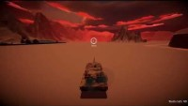
Product demonstration
03

Slide 6
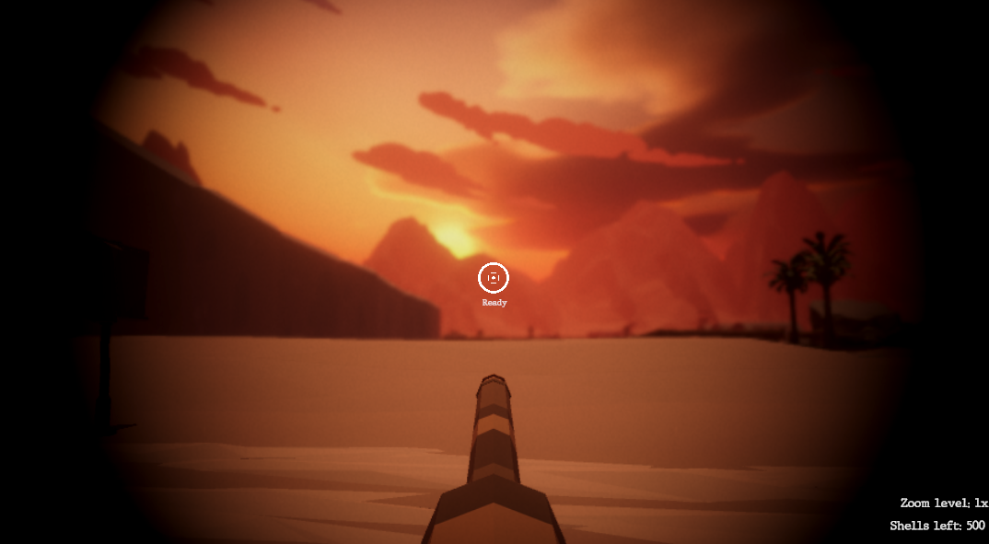
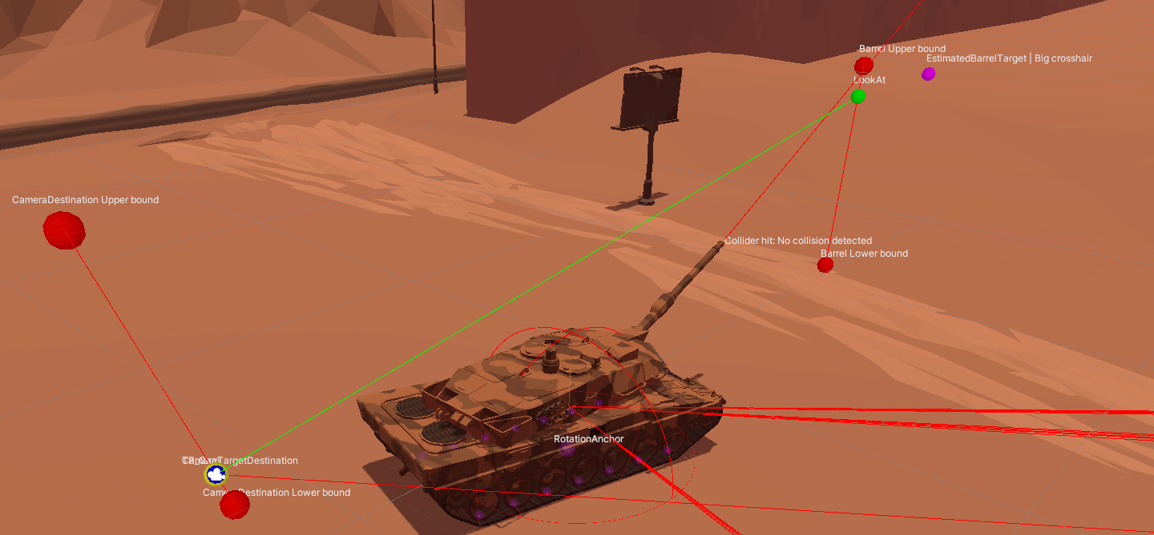
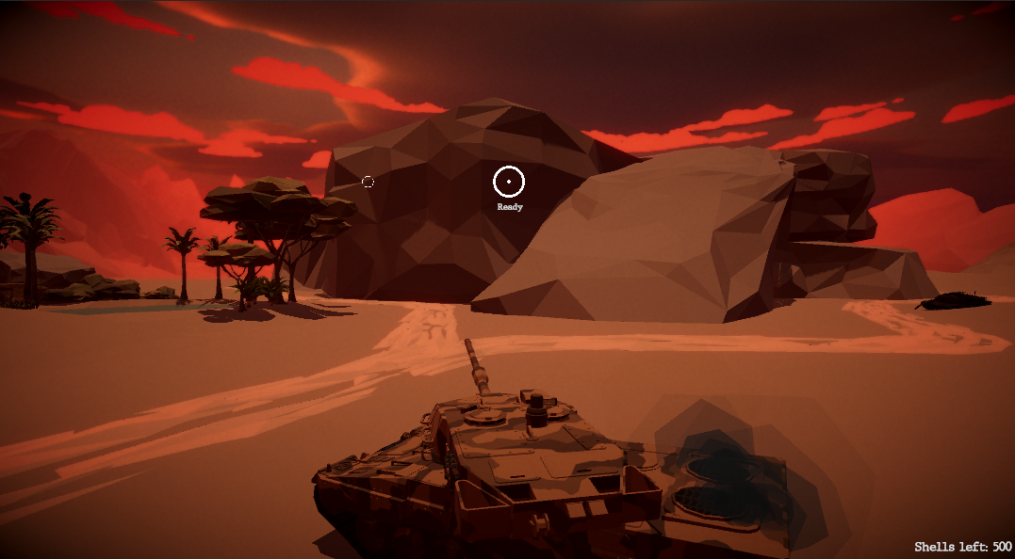
Highlights 1/2
Move component
04
Turret & camera control component
Original plan with WheelColliders didn’t work out.
Now “faking” movement by adding force & rotating tank.
Visualized as much as possible (learning goal)
Camera uses FSM (learning goal)
Several combat views

Slide 7
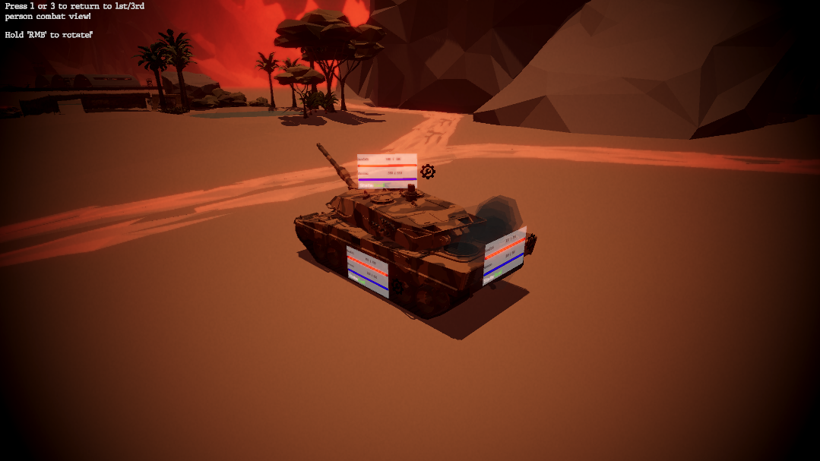
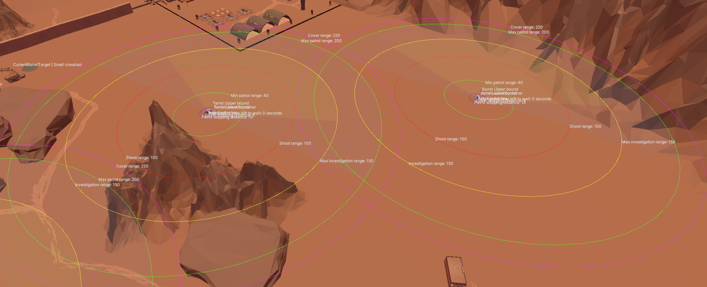
Highlights 2/2
Shoot component & damage registration
05
AI behaviour tree
Mildots/range finding (scrapped)
Drag coefficient
Self/hostile inspection view
Framework built from the ground up (learning goal(s))
Gizmo visualizations (learning goal)

Slide 8
Quality Assurance
Point 1
Point 2
Point 3
06
Term 3
Term 3.5
Term 4
Term 4.5
Glenn Comis – internship former lead dev
Yvens Serpa
Hans Wichman
Yvens Serpa
Mercury is the closest planet to the Sun
Venus is the second planet from the Sun
Despite being red, Mars is actually a cold place

Slide 9
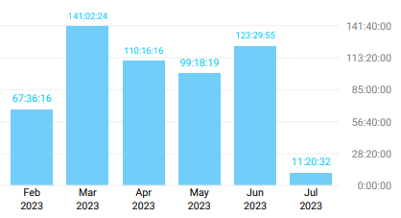
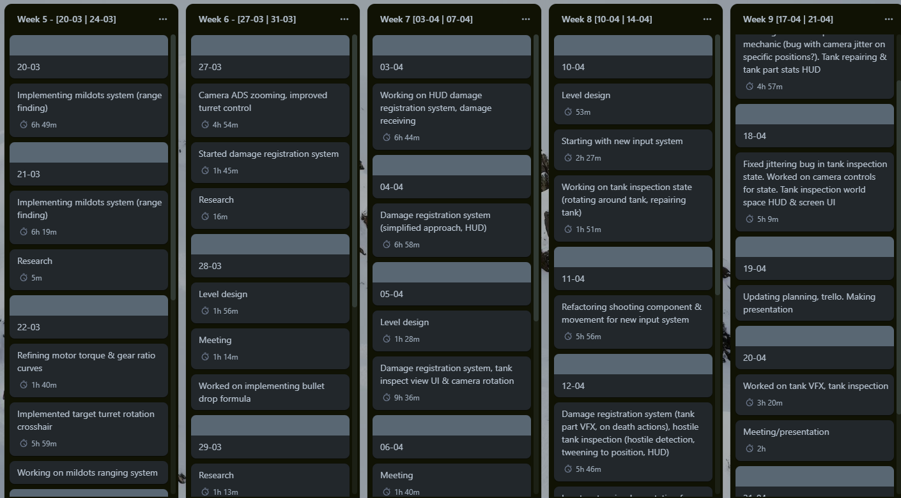
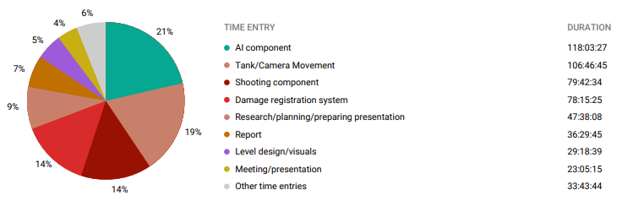
Hour registration & logging
Time spent
Logbook
07
Trello

Slide 10
Possible future plans*
Node editor behaviour tree
Improve behaviour tree capabilities
08
*if/when I have time to further develop this
Make “real” tracks/better movement system?
Improves usability of behaviour tree
Easier to debug and design
Add more node types
Add mutual AIBlackboard, so agents can work together
Rebuild movement system
More research (avoiding Wheel Colliders)
Range-finding system
Tank customization
Restart a range-finding system
Dive into mildots mechanics again?
Buying upgrades
Tank cosmetics
Customization menu

Slide 11
Self Reflection
Find more QA from the industry rather than teachers
Lower the bar
09
Make decisions to scrap mechanics earlier on in development
Rather than feedback from teachers (which is still great but not as relevant), get feedback from preferably tank game developers.
I find it hard to balance out my ambitions vs realistic workload. Lowering my expectations for myself might have resulted in better motivation = better product.
Improve on realizing when a feature isn’t going to work or requires too much time compared to hours in budget.

Slide 12
THANK YOU
Any questions?
Please keep this slide for attribution

